Slide 1
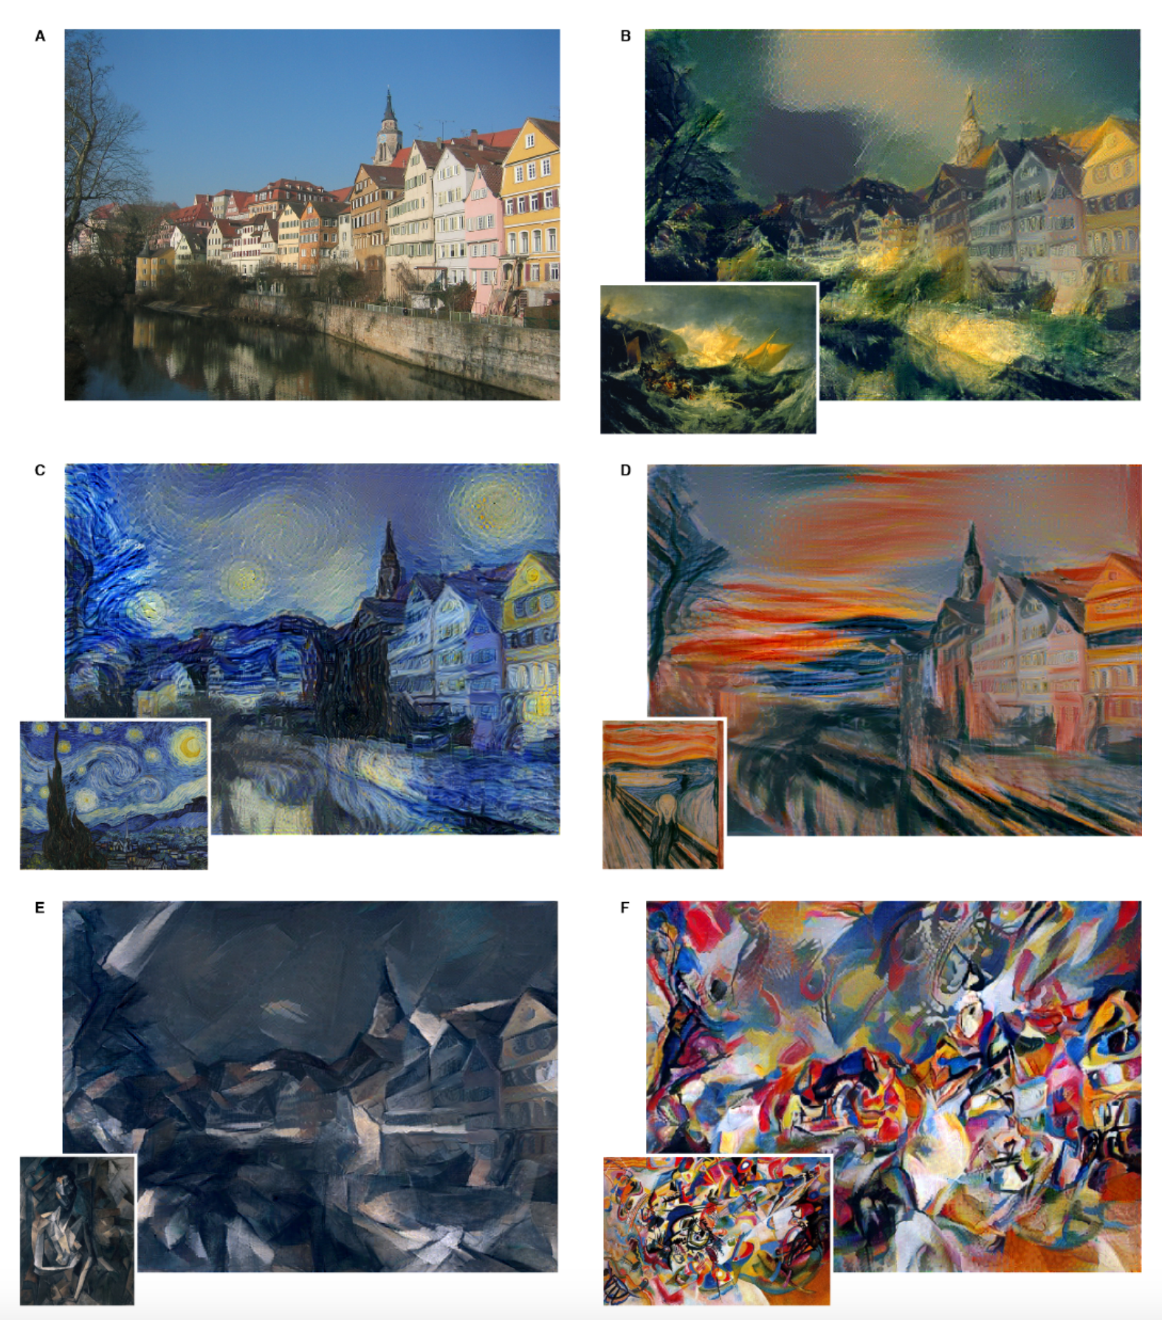
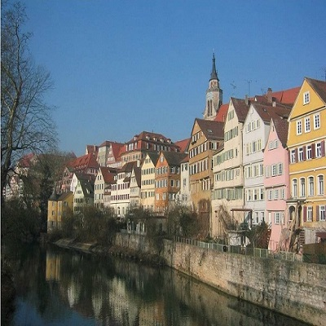
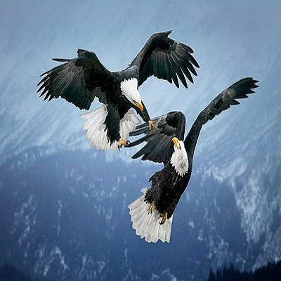

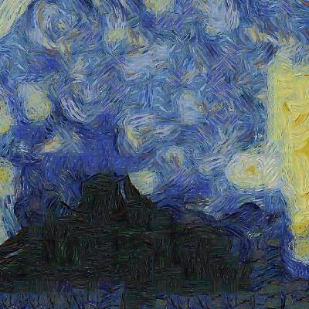
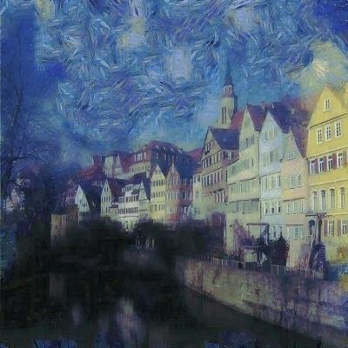
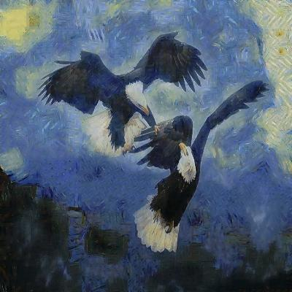
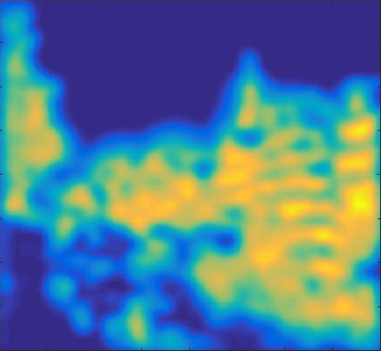
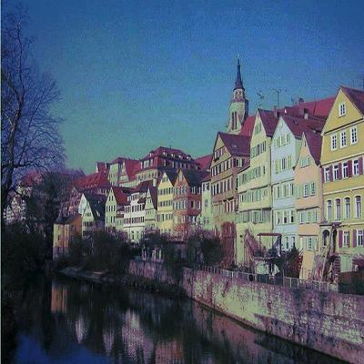
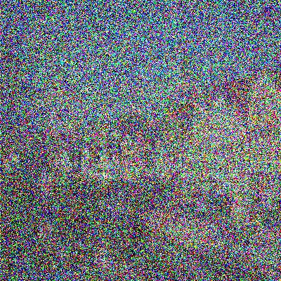
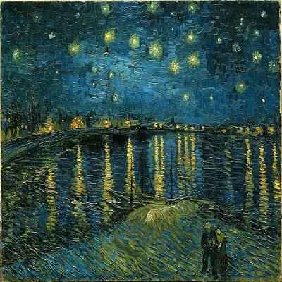
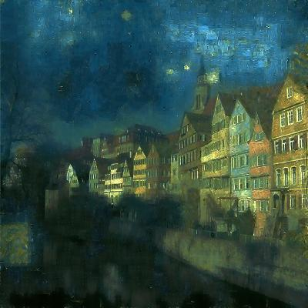
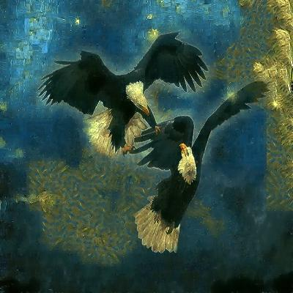
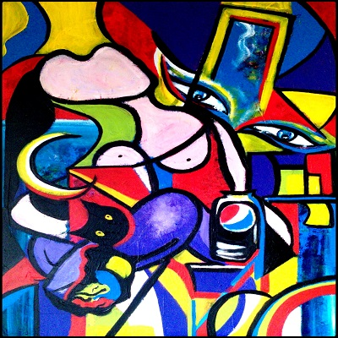
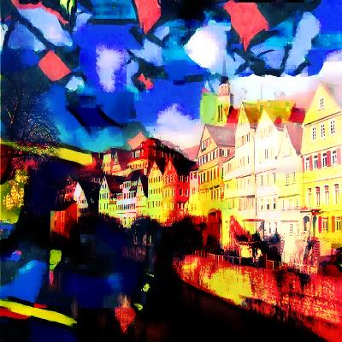
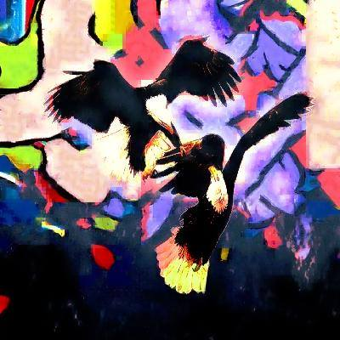
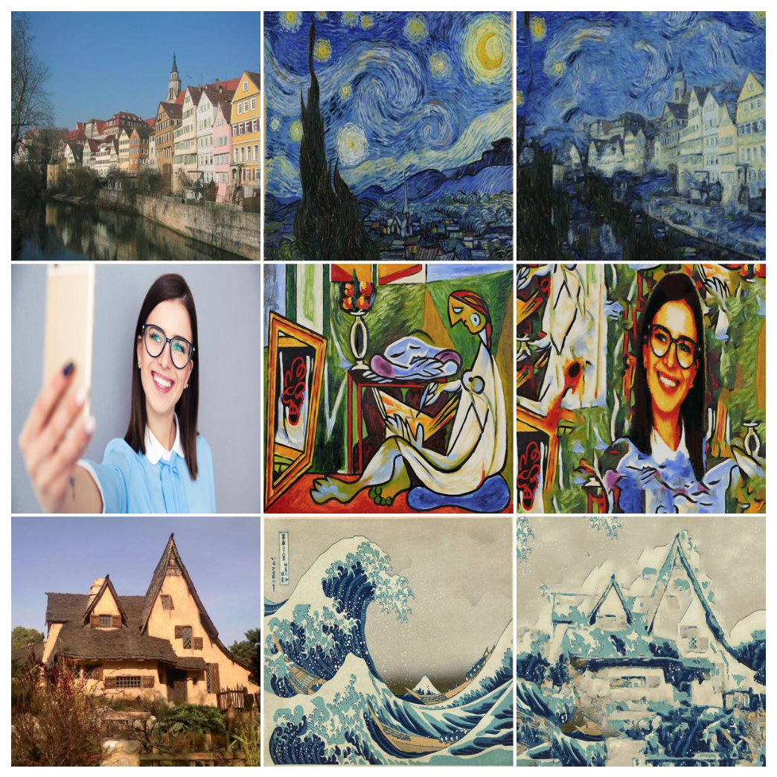
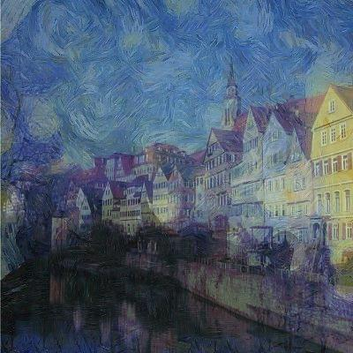

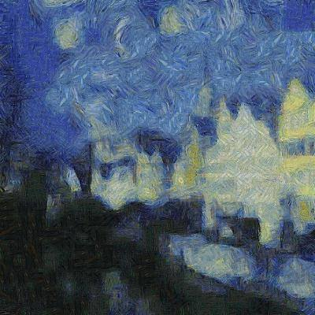
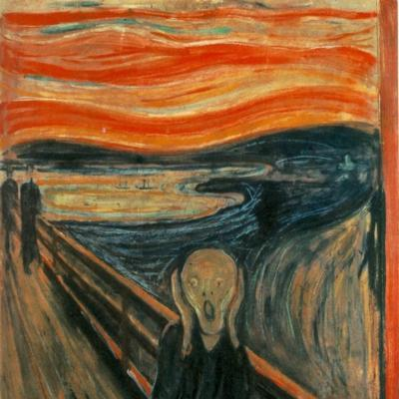
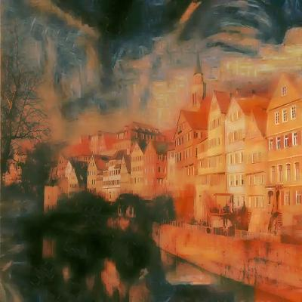
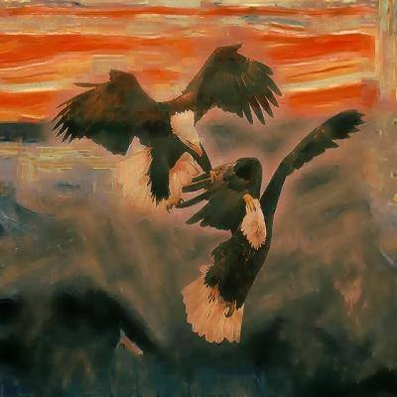
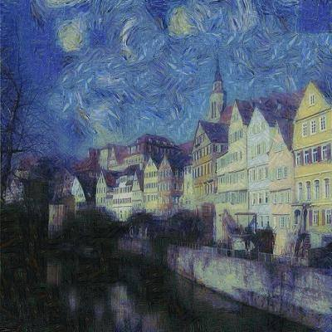
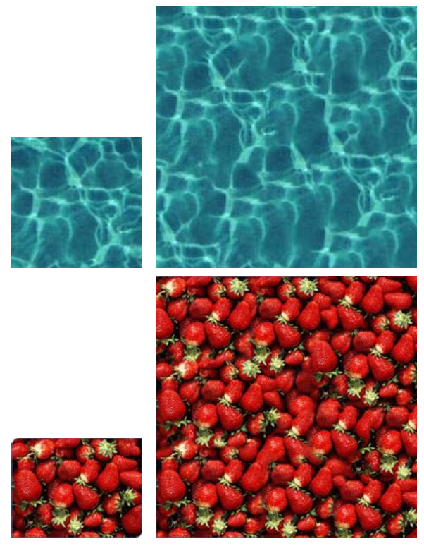
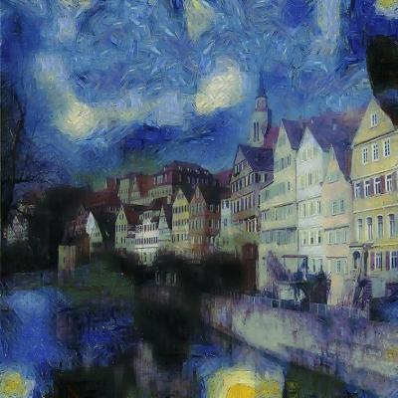
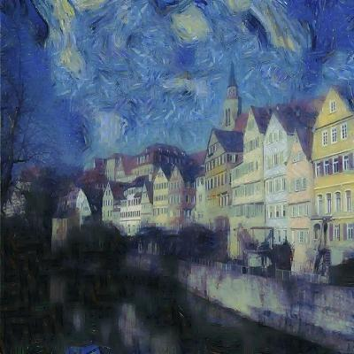
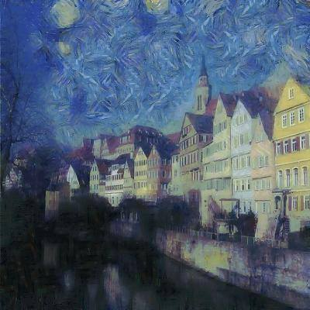
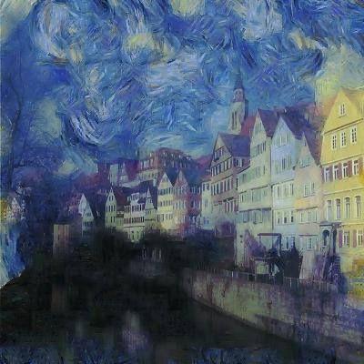
Artistic Style Transfer
Nicholas Tan, Elias Wang
Department of Electrical Engineering, Stanford University
Motivation
Algorithm Overview
Experimental Results
Using a biologically inspired vision model, called “Deep Neural Networks,” an artificial system can be trained to learn different styles of painting and subsequently recreate images rendered in that style.
The model is successful because it is able to distinguish between “style” vs. “content”, and merge the two.
Input:
Content Image
Style Image
Hallucination
Content
Style
Initialization:
Chosen parameters: 3 scales, 2 patch sizes (except smallest scale uses 3 patch sizes), 10% NN noise, 25%+75% hallucination averaging
Segmentation
Color transfer
Add noise
Source: L.A. Gatys, A.S. Ecker, and M. Bethge, Image Style Transfer Using Convolutional Neural Networks, CVPR, 2016.
Loop over scales:
Related Work
Loop over patch sizes:
Style Fusion
Patch Matching
Style Synthesis
Using a modification of Texture-Synthesis it is possible to get fast and comparable style-transfer results. This method focuses on separating information-poor areas to hallucinate the style and high content areas where it keeps the original image
Content Fusion
Resize Patch
Color Transfer
Denoise
Hallucination percentage influence :
0%
10%
25%
50%
Resize Estimate (finer scale)
Source: M. Elad, P. Milanfar, Style-Transfer via Texture-Synthesis, Google Research, September 21, 2016
Source: V. Kwatra, I. Essa, A. Bobick, and N. Kwatra, Texture Optimization for Example-Based Synthesis,ACM ToG, Vol. 24, No. 3, pp. 795-802, 2005

